Slide 1

PlateMate
Taste the difference
Group tags: Barta Máté (group leader)
Bene Dominik
Gere Csanád

Slide 2







The Goals of PlateMate
Simplification and Optimisation
Faster Service
Reduced Manual Work
Faster service and a better experience for guests.
Reducing manual work and the potential for errors.
Simplifying and optimising the operations of restaurants.
Digital Solutions
Increased Efficiency
Improved Customer Experience:
Replacing traditional, paper-based systems with digital solutions.
Making restaurant operations more efficient.
Online ordering, table booking and menu browsing.
Automated payment: faster, contactless service.

Slide 3



Used technologies
Front End
Back End
Database
The following technologies are used for the user interface development:
The server-side logic and API development is done using the following technologies:
The application's data management and storage is done using a MySQL-based database:
• HTML
• CSS
• JavaScript
• XAMPP Control Panel (v3.3.0)
• Vue.js (v5.0.8)
• Node.js (v20.17.0)
• MySQL (10.4.32-MariaDB
• Tailwind CSS (v3.4.13)
• Express.js (v4.21.1)
• NPM (v10.9.0)
• NPM (v10.9.0)

Slide 4









More detailed presentation of the programme
Booking Management
Home page and Navigation
Simple and efficient booking management.
Login
User login to the system.
Functions accessible through the navigation menu (for administrators).
Order Management
Efficient management of orders.

Slide 5
Program Functions - Job Roles
Administrator
Chef
Full access to all functions and pages of the application.
Access to functions related to kitchen operations and menu management.
Server
Cook
Access to table management, order taking, and billing functions.
Access to prepare dishes and fulfill orders.
The accounts associated with the job roles (except for the administrator) can only access the pages and functions related to their respective job roles in the application.

Slide 6
Key Components
Registration
Login
Logout
The registration function creates a new user, checks if the email address is already in use, and then securely stores the password using a hashing method in the database.
The login function first checks if there is a valid session. If not, it verifies the user's credentials, generates a JSON Web Token, and stores it in cookies.
The logout function deletes the user's session, while the refresh token generation function creates a new refresh token, allowing the access token to be renewed without the user having to log in again.

Slide 7
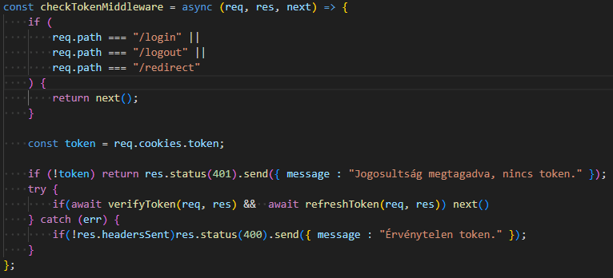
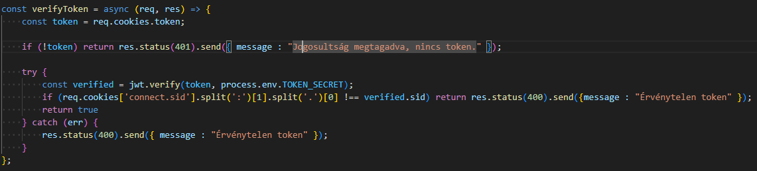
Code details
checkTokenMiddleware
verifyToken

Slide 8



Testing Environment and Methodology
Supertest
Jest
Asynchronous Testing
For sending requests to API endpoints and verifying HTTP responses.
Running tests and validating results in the development environment.
Testing asynchronous operations (database, HTTP requests) of API endpoints using async/await.

Slide 9
Key Functions and Tested Functions
POST /api/openingHours
GET /api/openingHours
DELETE /api/openingHours/:id
To successfully create an opening hour, the POST request response gives a 200 OK status code, indicating that the request was successful.
When retrieving the opening hours, the test checks that the system successfully returns all opening hours with a GET request.
The successful deletion tests that the system is able to delete a specific opening hour by ID and sends the appropriate message.

Slide 10



Development Opportunities
Modifying Table Locations
Flexible Booking Handling
Multilingual Support
Give users the ability to modify table arrangements.
Enhance the system to accommodate various booking scenarios.
Implement support for multiple languages to reach a broader audience.

